Slide 1
Python – if..else..elif statements
Premanand S

Slide 2
Decision making
Decision making process
If statement
If…else statement
If… elif…else statement
Nested if statement

Slide 3
If statement
If expression:
statement (s)
Expression true – statement will proceed
Expression false – statement will not proceed

Slide 4
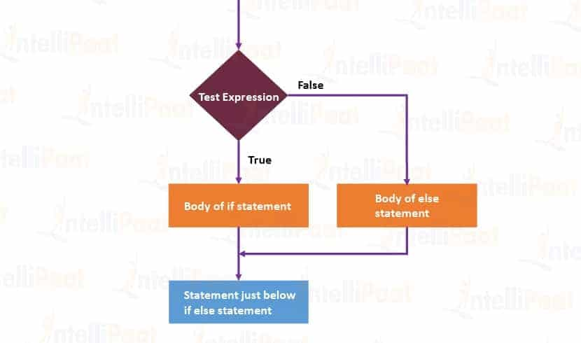
Flow chart – if statement

Slide 5
If else statement
if test expression:
Body of if
else:
Body of else
Expression true – body of if
Expression false – body of else

Slide 6
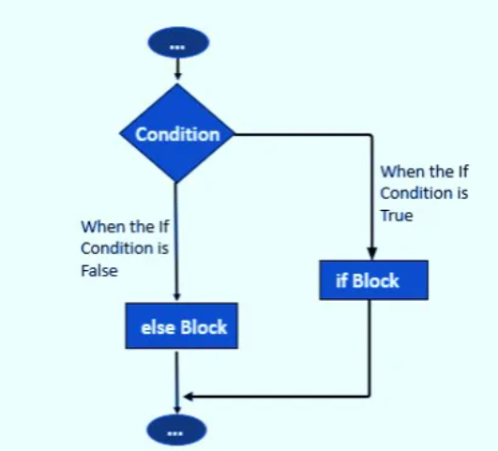
If else – flow chart

Slide 7
If … elif … else statement
if test expression:
Body of if
elif test expression:
Body of elif
else:
Body of else
Elif – else if condition
If – false – will check elif
All condition is false – body else will execute
If .. Elif … else (any one will execute)
The if block can have only one else block. But it can have multiple elif blocks

Slide 8
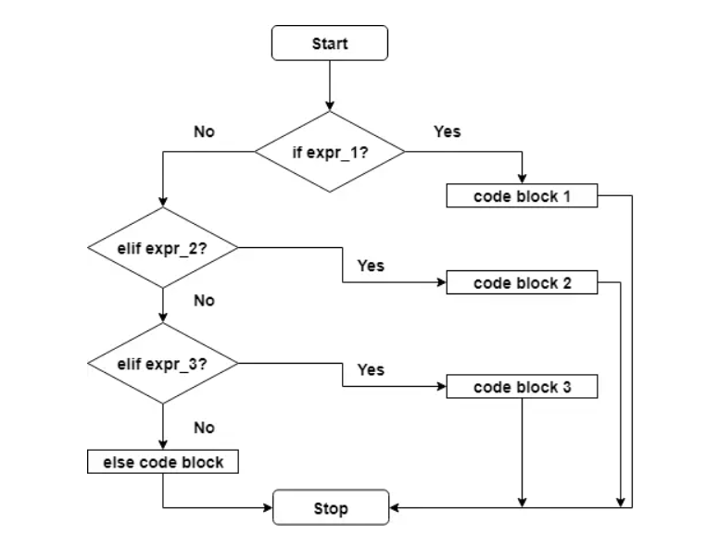
If… else… elif – flow chart

Slide 9
Nested if statement
We can have a if...elif...else statement inside another if...elif...else statement
Indentation is the only way to figure out the level of nesting.

Slide 10
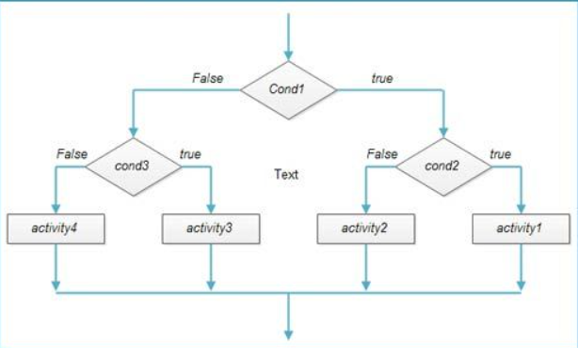
Nested if – flow chart

Slide 11
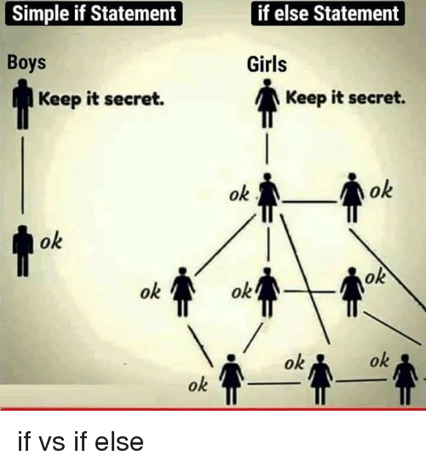
If statement – meme explanation

